Slide 1
Introduction to Assembly
Slides by Marius Wiik
Based on PDF by Erlend Helland Graff

Slide 2
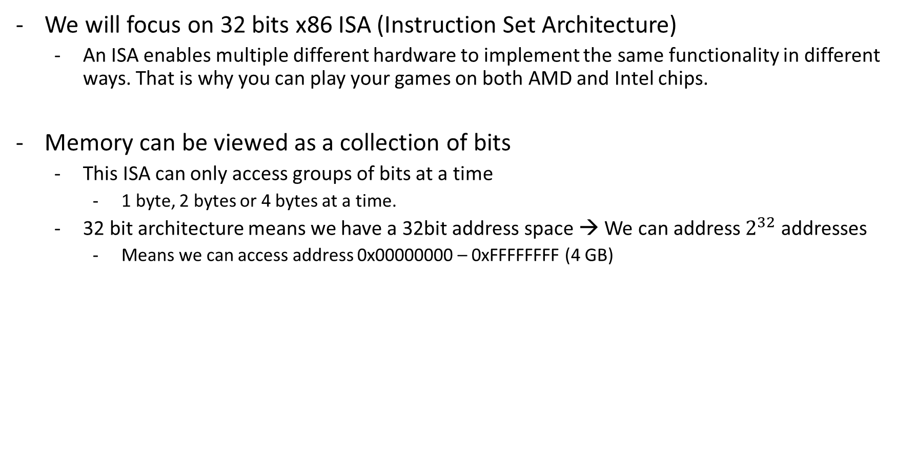
Introduction
We will focus on 32 bits x86 ISA (Instruction Set Architecture)
An ISA enables multiple different hardware to implement the same functionality in different ways. That is why you can play your games on both AMD and Intel chips.
Memory can be viewed as a collection of bits
This ISA can only access groups of bits at a time
1 byte, 2 bytes or 4 bytes at a time.
32 bit architecture means we have a 32bit address space → We can address $2^{32}$ addresses
Means we can access address 0x00000000 – 0xFFFFFFFF (4 GB)

Slide 3
Introduction (2)
On a low level, programming is all about moving numbers around
Assembly can be considered as human readable binary.
Assembly does not have variables in the traditional sense!
We use temporary, very quick storage units called registers.
We will only use integer registers.
Moving numbers between registers is extremely quick, only a few clock cycles
Accessing memory is slow in comparison, several hundred clock cycles
The x86 ISA does not provide a way to move numbers from one memory location to another, so we need to use the registers.
We want to use as few memory accesses as possible, so utilize those registers! ☺

Slide 4
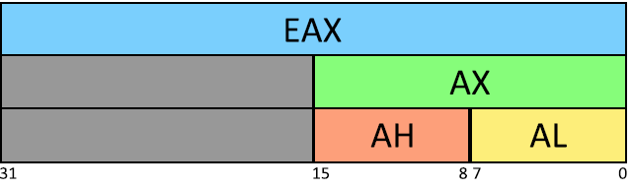
Introduction (3)
x86 has eight GPRs (general purpose registers)
These are 16 bit integer registers
There is also an extended version. Prefixed with “E”
“EAX, ECX etc”
On the registers ending with “X” we can access each of the two bytes separately
Switch the X with H (high) or L (low)
Name | Legacy Usage
AX | Accumulator register
CX | Counter register
DX | Data register
BX | Base register
SP | Stack pointer
BP | Base pointer
SI | Source index register
DI | Destination index register

Slide 5

Some assembly
Two syntaxes are used (Intel assembly and AT&T / GAS)
We will use AT&T / GAS
Be careful when looking up resources online. Check which syntax the examples are using
An easy way to check is to see if the registers are prefixed with “%”, for example %eax. Then it is AT&T / GAS
The instruction INC is used to increment the value of a destination operand. The letter that comes after the instruction “INC” decides which data size we’re working with
b for byte, w for word (2 bytes) l for long (4 bytes)

Slide 6


Some assembly (2)
Some instruction examples
Immediate values are prefixed with «$» and comments starts with «#»
Instruction | Effect
INC | Increment value
DEC | Decrement value
ADD | Add source to destination
SUB | Subtract source from destination

Slide 7
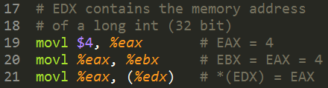
Some assembly (3)
Another important instruction is “MOV”. Used to move data into a register, memory space, between two registers or between a register and memory
Remember: You can not move data between two memory locations
On the last line we copy the contents of EAX into the MEMORY ADDRESS that resides in EDX.

Slide 8
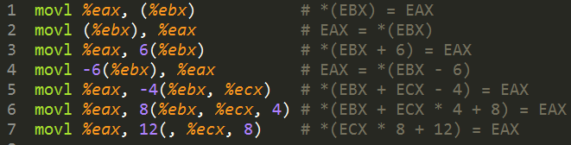
Some assembly (4)
As in C, we can also manipulate pointers in assembly
Remember if you incremented a pointer in C it incremented a multiple of the size of the data type it pointed to?
Assembly doesn’t. And that is easier to relate to (kinda).
Assembly increments as if it was an integer (as far as the assembler knows it is)
Denoted by having parenthesis around the register containing the memory address

Slide 9
Some assembly (5)
Instructions are read and executed sequentially from memory
The ISA guarantees that the effect of one instruction will be active before the next instruction is executed.
A register called the program counter (PC) or instruction pointer (IP) is used to know the memory address of the current instruction being executed.
In x86 this register is called EIP
We cannot access this register directly but we can change the value using jump instructions
The jump instruction is used to break the sequential execution flow
If you do a function call, use loops or conditional statements.
We can define places to jump by using labels

Slide 10
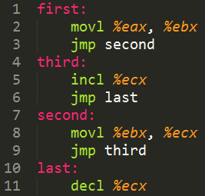
Some assembly (6)
Two types of jump: conditional or unconditional
Can use CMP instruction to create conditional jumps
Instruction | Jump if | Meaning
JE | Equal | A == B
JNE | Not equal | A != B
JB | Below (unsigned) | A < B
JA | Above (unsigned) | A > B
JBE | Below or equal (US) | A <= B
JAE | Above or equal (US) | A >= B
JL | Less (signed) | A < B
JG | Greater (signed) | A > B
JLE | Less or equal (S) | A <= B
JGE | Greater or equal (S) | A >= B

Slide 11
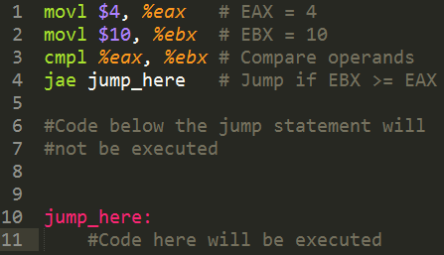
Some assembly (7)
The CMP instruction compares two operands and updates an internal EFLAGS-register based on the comparison. The conditional JMP-instructions will read that information and act based on it
If the instruction is CMP op1, op2
The jump will happen if:
Op2 JAE op1
Reversed of what you might think?

Slide 12
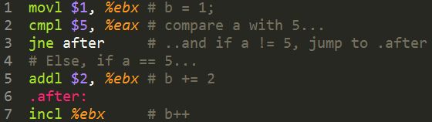
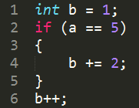
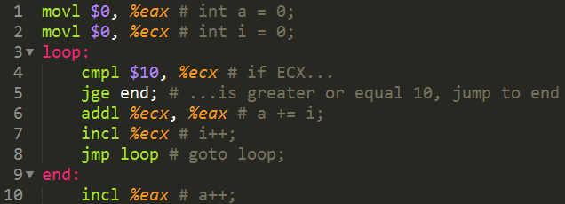
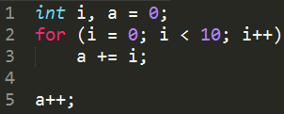
Two examples

Slide 13
The stack
The registers ESP and EBP mentioned earlier are used to maintain the stack. This is a very important data structure provided by the operating system and is used to store auto variables (variables that are local to a function), temporary data, function arguments and return addresses for function calls.
The stack grows downwards in memory from a high address to a low
ESP (Stack pointer) always points to the top of the stack (lowest memory address) and will therefore always contain the memory address of the last byte put on the stack.
Data below ESP is considered garbage.
When we enter a function we create a new stack frame. A limited portion of the total program stack that is local for this particular function
EBP is used to keep track of the bottom of the stack, so that the stack is limited from the base pointer (highest address) to the stack pointer (lowest address)

Slide 14

The stack (2)
The ISA defines two operations, push and pop to make working with the stack easier.
Push adds something to the stack
Pop removes something from the stack
Note that pushb or popb is not allowed as the stack is 16-bit aligned.
It is important to maintain symmetry between push and pop operations
Remove as much as you have added!

Slide 15
The stack (3)
- The stack operations affect the stack pointer (ESP), since it always points to the top of the stack
Hopefully, you will not have to deal with endianness, but note this:
X86 is a little-endian architecture.
Lets say the register EAX has the value 0x01234567 and we want to move the value into memory address 0xABCD0000
How will the four bytes that is the value of EAX be located in relation to the address?
Address | Byte
0xABCD0000 | 0x01
0xABCD0001 | 0x23
0xABCD0002 | 0x45
0xABCD0003 | 0x67
Address | Byte
0xABCD0000 | 0x67
0xABCD0001 | 0x45
0xABCD0002 | 0x23
0xABCD0003 | 0x01
Notes:
Data vil legge seg fra laveste eller minst signifikante byte til høyeste og mest signifikante. Det vil si at byten på første addresse vil få den siste verdien I verdistrengen.
På den positive siden vil det se veldig rett ut når man ser på hvordan det ser ut på stacken.

Slide 16
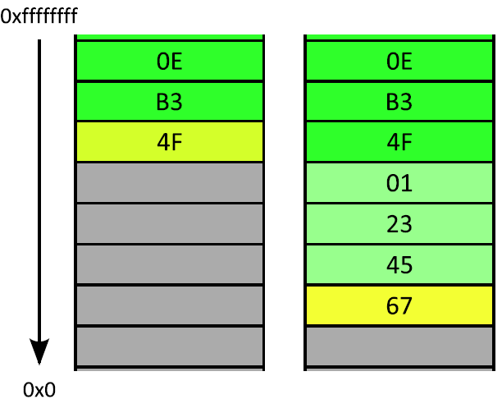

The stack (4)
This shows the stack before and after
The yellow fields represents the ESP register
At any time, you can remove data you have pushed by adding to the ESP register
Can also reserve space on the stack by subtracting

Slide 17
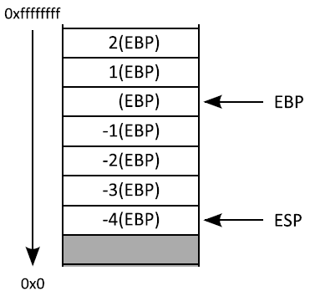
The stack (5)
With all the adding, subtracting, pushing and popping the ESP will be in constant movement
The base pointer will however never move within a stack frame.
To create a new stack frame you need to:
Store the old value of EBP on the stack (push)
Copy the value of stack pointer into the base pointer
This is generally the first thing you do when entering a function
The last thing? Pop that EBP! ☺

Slide 18

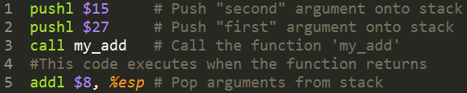
Functions
Different calling conventions for functions. We are going to use CDECL
This means there are rules to follow when calling and creating functions.
All arguments are put on the stack from right to left.
CALL is almost the same as an unconditional jump, but CALL will first push EIP on the stack.
This means that the function can return to where it was called from.
RET returns from a function after popping four bytes of the stack and into EIP
This really illustrates why the push/pop symmetry needs to be followed. What happens if the bytes popped into EIP is some random number you have stored on your stack? ☺

Slide 19
Functions (2)
CEDCL also states that the registers EAX, ECX and EDX is caller saved. That means that a function can freely use these registers without thinking about the contents
Remember: Your entire program shares the same registers
It also means that if you want to use EBX, ESI or EDI you first have to store the old values before touching them, and restore the values before returning (push, pop)
If you don’t you will probably mess up something for the caller!
It is also defined that the return value of a function should always be stored in EAX before returning (Does not apply for floating point numbers, but don’t think about that)

Slide 20
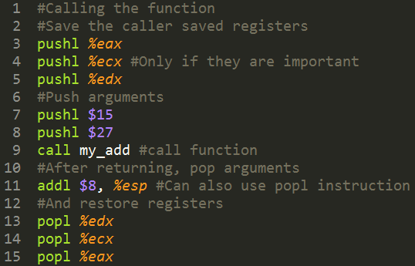
Example

Slide 21
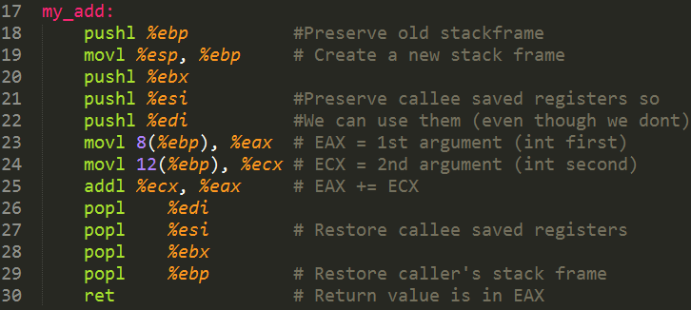
Example – The function
Notes:
Hvorfor er første argument på 8 av EBP og ikke 4 (32 bit) ?
Fordi der ligger den gamle EIP (instruction pointer) og vi trenger den for å returnere der vi var

Slide 22
Resources
https://en.wikipedia.org/wiki/X86_calling_conventions
https://en.wikibooks.org/wiki/X86_Assembly/GAS_Syntax
https://www.cs.swarthmore.edu/~newhall/cs31/resources/IA32_Cheat_Sheet.pdf

Slide 23
Questions?

